Slide 1

LOGify: AI-Powered Log Management System for Modern Infrastructure
Transform scattered server logs into automated intelligence. Detect issues before they impact your business. Scale without adding monitoring teams.

Slide 2

The Growing Log Crisis
What's Happening Now
The Real Cost
Dedicated manpower for log management
Expensive infrastructure for storage
Critical issues detected too late
Revenue lost during downtime
Every growing company operates multiple servers—cloud instances, microservices, containers, and databases. Each generates thousands to millions of log entries daily.
But logs scatter across different servers, forcing teams to manually monitor multiple systems simultaneously.

Slide 3








Manual Monitoring = Missed Opportunities
Time Loss
Revenue Loss
Engineers manually search through logs across multiple systems when issues arise
Payment service crashes at 2 AM mean delayed detection and lost transactions
High Operational Cost
Human Dependency
Companies invest heavily in both infrastructure and monitoring teams
Even centralized tools require manual interpretation and analysis
Traditional log tools centralize data—but they're not intelligent. The gap remains: automated pattern recognition and root cause analysis.

Slide 4






Who Needs LOGify
Tech Startups
SaaS Companies
Cloud infrastructure monitoring without building dedicated teams
Multi-tenant environments with complex service dependencies
FinTech Platforms
E-commerce Companies
High-stakes transaction monitoring and compliance logging
Peak traffic handling with zero downtime tolerance
Enterprises
IT Management
Multi-server environments across global data centers
Service providers handling infrastructure for multiple clients
Any company running multiple servers is a potential customer for automated log intelligence.

Slide 5

Four Major Impact Areas
Cost Reduction
1
Less manpower required for monitoring
Reduced infrastructure dependency
Cloud-based setup eliminates hardware costs
Faster Incident Response
2
AI detects issues instantly, not hours later
Visual and intelligent alerts prioritize critical problems
Reduced downtime protects revenue
Smarter Decision Making
3
Pattern detection identifies recurring issues
Root cause analysis prevents future problems
Predictive monitoring flags potential failures
Scalable for Growth
4
As servers scale, AI scales automatically
No need to proportionally grow monitoring teams
Same platform handles 10 servers or 10,000

Slide 6

Competitive Landscape
Traditional Log Tools
Centralized storage with manual analysis required
LOGify
AI-powered pattern detection and automated root cause identification
Manual Search Required
Users must know what to look for and search through logs manually
Natural Language Queries
Ask "Why did the server crash?" and get automated answers
Separate Infrastructure
Requires dedicated servers and storage hardware
Cloud-Native
Lightweight agents stream directly to cloud dashboard

Slide 7









Technical Architecture
Lightweight Agents
Deploy on every server to collect logs in real-time
Cloud Dashboard
Unified interface with all logs streamed and stored
AI Engine
Automatic pattern recognition and anomaly detection
Smart Alerts
Root cause analysis delivered to your teams

Slide 8

Building the Future of Infrastructure Monitoring
Our Vision
Companies generate billions of log entries daily. LOGify converts scattered data into automated intelligence.
We reduce costs. We eliminate manual monitoring. We increase system reliability through AI-powered pattern detection.
Next Milestones
Automated fix suggestions
Self-healing system integration
Predictive failure prevention
AI-Native Observability
The future is automated, intelligent, and scalable
Thank You

Slide 9
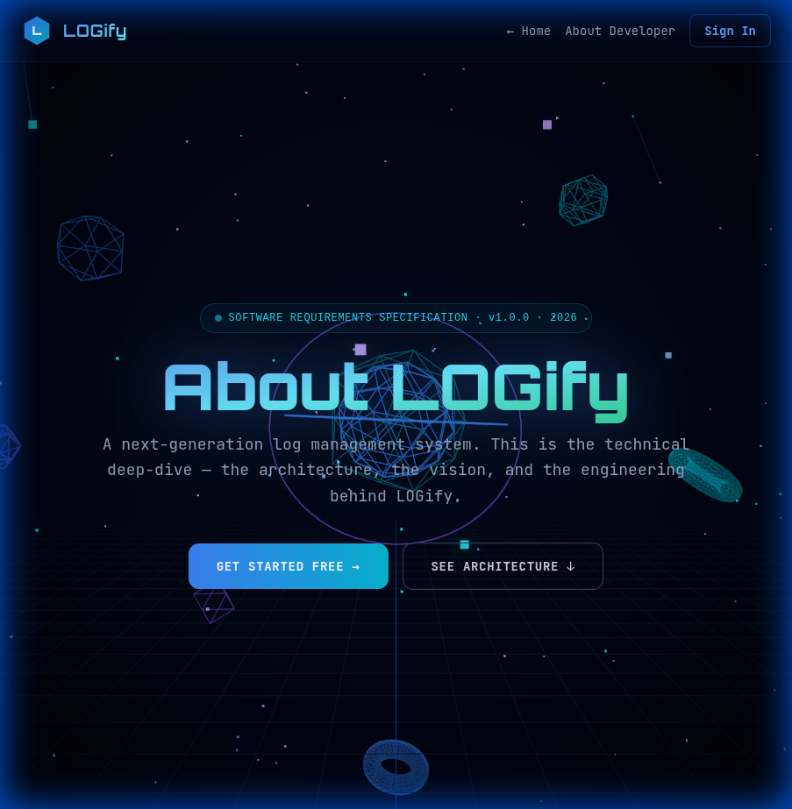

Thank You

